Slide 1



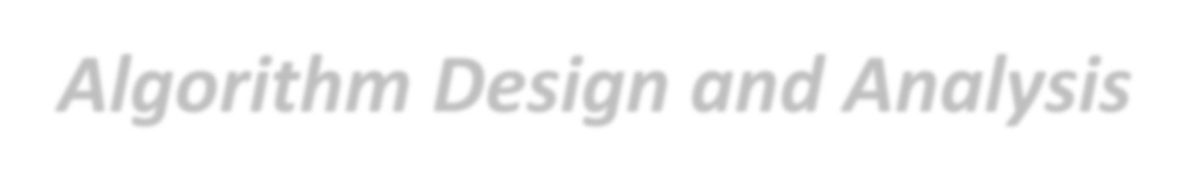


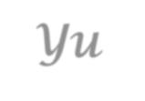
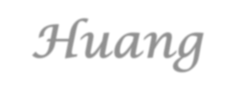

Introduction to
Algorithm Design and Analysis
[9] Hashing
Yu Huang
http://cs.nju.edu.cn/yuhuang Institute of Computer Software Nanjing University

Slide 2

In the last class…
The searching problem
o Organization of data
Binary search
o logn search over sorted data
Red-black tree
o logn search over BST
Definition
Insertion, deletion

Slide 3

Hashing
The searching problem
The ambition of hashing
Hashing
Direct-address table
Basic idea of hashing
Collision Handling for Hashing
Closed Address Hashing
Open Address Hashing
Array Doubling and Amortized Analysis

Slide 4

The Searching Problem
Searching vs. Selection
Search for “Alice” or ”Bob”
The key itself matters
Select the “rank 2” student
The partial order relation matters
The ambition of hashing
Brute force case: O(n)
Ideal case: O(1)
Hashing: O(1+𝛼𝛼)

Slide 5



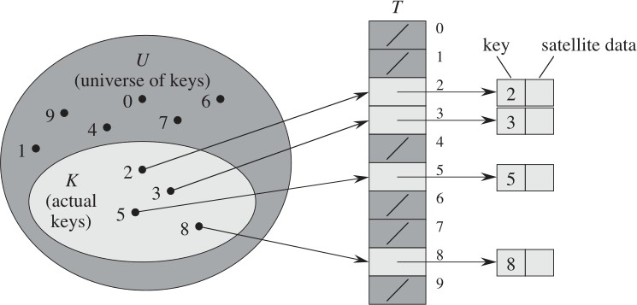
Searching -
a Brute Force Approach
Direct-address table
o Take into account the whole universe of keys
Direct-address Table
DIRECT-ADDRESS-SEARCH (T, k)
return T[k]
DIRECT-ADDRESS-INSERT (T, x)
T[key[x]] := x
DIRECT-ADDRESS-DELETE (T, x) T[key[x]] := NIL

Slide 6





Hashing: the Idea
Hash Table (in feasible size)
Very large, but only a small part is used in an application
x
Key Space
Value of a specific key
E[0]
E[1]
Index distribution
Collision handling
Hash Function
H(x)=k
E[k]
A calculated array index for the key
E[m-1]

Slide 7









Collision Handling: Closed Address
Each address is a linked list
k₁
k₄
k₁
k₅
k₂
k₇
k₄
k₂
k₇
k₅
Insert to the head of the list
k₃
k₆
k₆
k₃

Slide 8



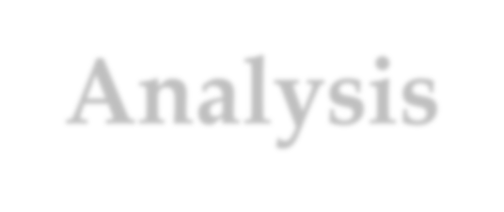
Closed Address - Analysis
Assumption - simple uniform hashing
For j=0,1,2,...,m-1, the average length of the list at E[j] is n/m.
The average cost of an unsuccessful search:
Any key that is not in the table is equally likely to hash to any of the m address.
Total cost Θ(1+ n/m)
The average cost to determine that the key is not in the list E[h(k)] is the cost to search to the end of the list, which is n/m.

Slide 9



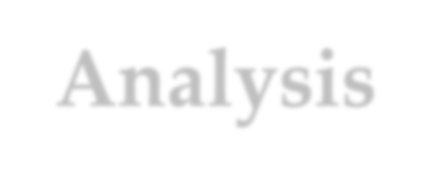
Closed Address - Analysis
For successful search (assuming that x_{i} is the i^{th} element inserted into the table, i=1,2,...,n)
For each i, the probability of that x_{i} is searched is 1/n.
For a specific x_{i}, the number of elements examined in a successful search is t+1, where t is the number of elements inserted into the same list as x_{i}, after x_{i} has been inserted
1
n
_{n}∑1+ t
( )
i=1
How to compute t?
o Consider the construction process of the hash table

Slide 10
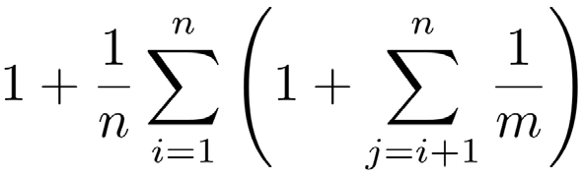
Closed Address - Analysis
For successful search: (assuming that x_{i} is the i^{th} element inserted into the table, i=1,2,...,n)
For each i, the probability of that x_{i} is searched is 1/n.
For a specific x_{i}, the number of elements examined in a successful search is t+1, where t is the number of elements inserted into the same list as x_{i}, after x_{i} has been inserted. And for any j, the probability of that x_{j} is inserted into the same list of x_{i} is 1/m. So, the cost is:
Expected number of
Cost for
elements in front of the searched one in the same linked list.
computing hashing

Slide 11

Closed Address: Analysis
The average cost of a successful search:
o Define α=n/m as load factor,
The average cost of a successful search is :
1
n
n
⎛ 1 ⎞
1 1
∑
n
n
(n − i) = 1+
n−1
⎜
1+
∑
⎟
⎠
= 1+
∑
∑
i=1
i
i=1 ⎝
m
nm
nm
j =i+1
i=1
= 1+ ^{n −1} = 1+ ^{α} − ^{α} = Θ(1+ α )
2m 2 2n
Number of elements in front of the searched one in the same linked list

Slide 12

Collision Handling: Open Address
All elements are stored in the hash table
No linked list is used
The load factor α can not be larger than 1.
Collision is settled by “rehashing”
A function is used to get a new hashing address for each collided address
The hash table slots are probed successively, until a valid location is found.
The probe sequence can be seen as a permutation of (0,1,2,..., m-1)

Slide 13

Commonly Used Probing
Linear probing:
Given an ordinary hash function h’, which is called an auxiliary hash function, the hash function is: (clustering may occur)
h(k,i) = (h’(k)+i) mod m (i=0,1,...,m-1)
Quadratic Probing:
Given auxiliary function h’ and nonzero auxiliary constant c₁
and c₂, the hash function is: (secondary clustering may occur)
h(k,i) = (h’(k)+c₁i+ c₂i²) mod m (i=0,1,...,m-1)
Double hashing:
Given auxiliary functions h₁ and h₂, the hash function is:
h(k,i) = (h₁(k)+ ih₂(k)) mod m (i=0,1,...,m-1)

Slide 14
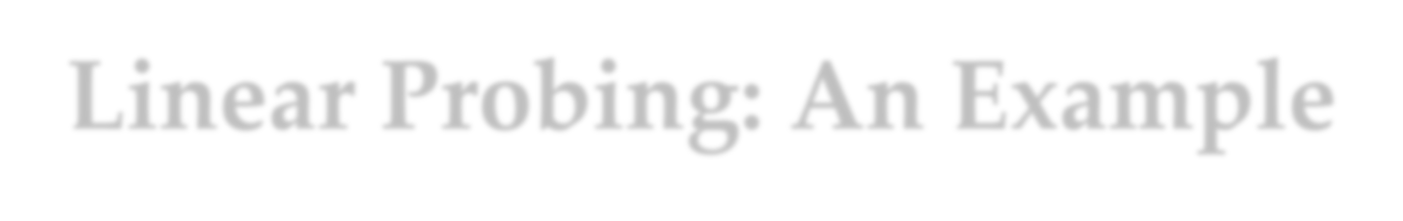




Linear Probing: An Example
Index
H
Hash function: h(x)=5x mod 8
0
1
2
3
rehashing ⁴
5
6
7
1776
1055
1492
1812
1918
1945
1812
1945
Rehash function: rh(j)=(j+1) mod 8
chain of rehashings

Slide 15

Equally Likely Permutations
Assumption
Each key is equally likely to have any of the m! permutations of (1,2...,m-1) as its probe sequence.
Note
Both linear and quadratic probing have only m distinct probe sequence, as determined by the first probe.

Slide 16


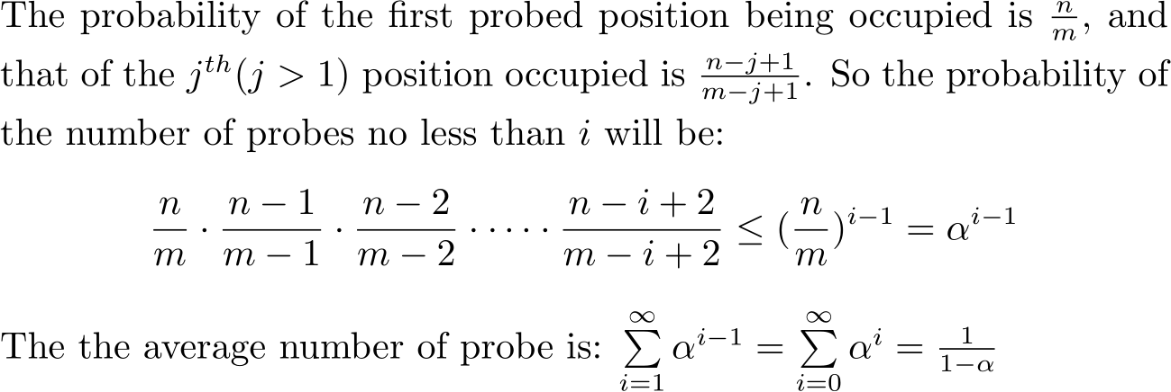
Analysis for Open Address Hashing
The average number of probes in an unsuccessful search is at most 1/(1-α) (α=n/m<1)
o Assuming uniform hashing

Slide 17
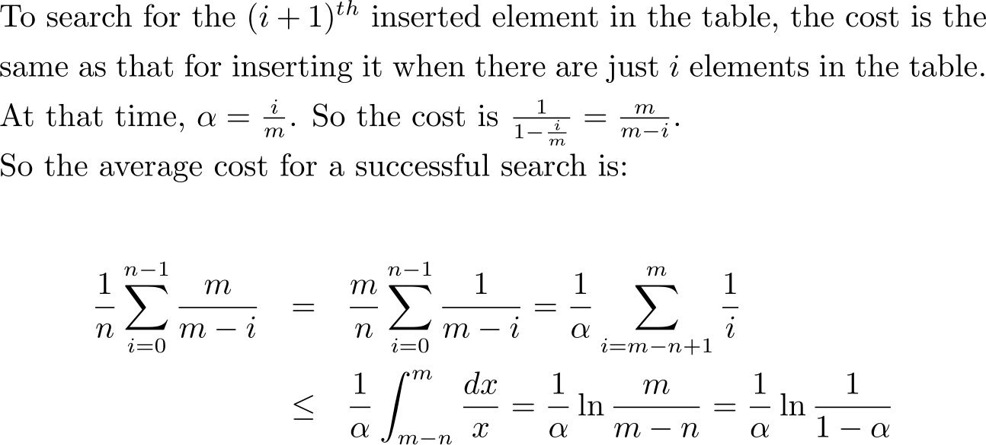


Analysis for Open Address Hashing
The average cost of probes in an successful
1 _{ln} 1
α 1−α
search is at most
(α=n/m<1)
o Assuming uniform hashing
For your reference:
Half full: 1.387;
90% full: 2.559

Slide 18

Hash Function
A good hash function satisfies the assumption of simple uniform hashing.
Heuristic hashing functions
The division method: h(k)=k mod m
The multiplication method: h(k)=⎣m(kA mod 1)⎦ (0<A<1)
No single function can avoid the worst case Θ(n).
So, “Universal hashing” is proposed.
Rich resource about hashing function
Gonnet and Baeza-Yates: Handbook of Algorithms and Data Structures, Addison-Wesley, 1991.

Slide 19

Array Doubling
Cost for search in a hash table is Θ(1+α)
If we can keep α constant, the cost will be Θ(1)
What if the hash table is more and more loaded?
Space allocation techniques such as array doubling may be needed.
The problem of “unusually expensive” individual operation.

Slide 20


Looking at the Memory Allocation
hashingInsert(HASHTABLE H, ITEM x)
integer size=0, num=0;
if size=0 then allocate a block of size 1; size=1;
if num=size then
allocate a block of size 2size;
move all item into new table;
size=2size;
insert x into the table;
num=num+1;
return
Insertion with expansion: cost size
Elementary insertion: cost 1

Slide 21

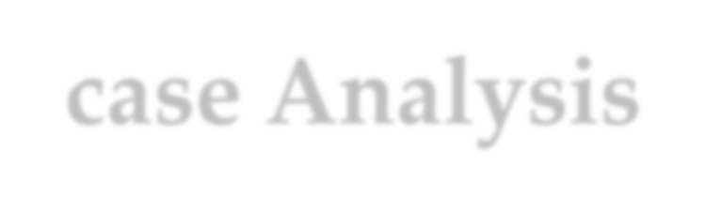

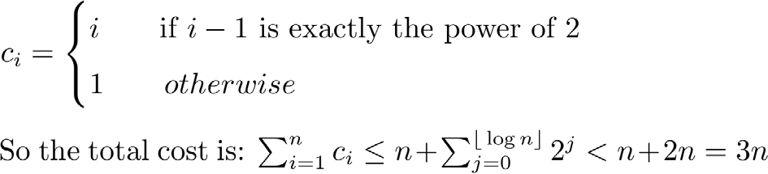
Worst-case Analysis
For n execution of insertion operations
A bad analysis: the worst case for one insertion is the case when expansion is required, up to n
So, the worst case cost is in O(n²).
Note the expansion is required during the ith operation only if i=2^{k}, and the cost of the ith operation

Slide 22



Amortized Analysis – Why?
Unusually expensive operations
E.g., Insert-with-array-doubling
Relation between expensive and usual operations
Each piece of the doubling cost corresponds to some previous insert

Slide 23

Amortized Analysis
Amortized equation:
amortized cost = actual cost + accounting cost
Design goals for accounting cost
In any legal sequence of operations, the sum of the accounting costs is nonnegative.
The amortized cost of each operation is fairly regular, in spite of the wide fluctuate possible for the actual cost of individual operations.

Slide 24



Amortized Analysis: MultiPop Stack
Pop: Cost=1
MultiPop: Cost=min(s,t)
Push: Cost=1
s
t
Amortized cost: push:2; pop, multipop: 0

Slide 25


Amortized Analysis: Binary Counter
0 0 0 0 0 0 0 0 0
1 0 0 0 0 0 0 0 1
2 0 0 0 0 0 0 1 0
3 0 0 0 0 0 0 1 1
4 0 0 0 0 0 1 0 0
5 0 0 0 0 0 1 0 1
6 0 0 0 0 0 1 1 0
7 0 0 0 0 0 1 1 1
8 0 0 0 0 1 0 0 0
9 0 0 0 0 1 0 0 1
10 0 0 0 0 1 0 1 0
11 0 0 0 0 1 0 1 1
12 0 0 0 0 1 1 0 0
13 0 0 0 0 1 1 0 1
14 0 0 0 0 1 1 1 0
15 0 0 0 0 1 1 1 1
16 0 0 0 1 0 0 0 0
0
1
3
4
7
8
10
11
15
16
18
19
22
23
25
26
31
Cost measure: bit flip
amortized cost: set 1: 2
set 0: 0

Slide 26


Accounting Scheme for Stack Push
Push operation with array doubling
No resize triggered: 1
Resize(n→2n) triggered: nt+1 (t is a constant)
Accounting scheme (specifying accounting cost)
No resize triggered: 2t
Resize(n→2n) triggered: -nt+2t
So, the amortized cost of each individual push operation is 1+2t∈Θ(1)

Slide 27


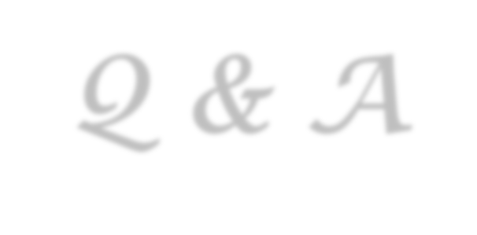

Thank you!
Q & A
Yu Huang
http://cs.nju.edu.cn/yuhuang

